Slide 1
The Activity Lifecycle
Session 3
Course : Mobile Community Solution
Effective Period : September 2019

Slide 2
Learning Objectives
At the end of this meeting is expected that students will be able to:
  Describe the main features of Android Programming and Android Software Development
  Produce simple Mobile Application using the main features of Android

Slide 3
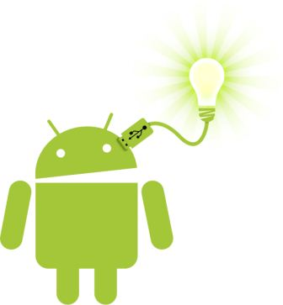
Contents
Understanding Activities
Activity Life Cycle
Activity Monitoring
How do activities really work?
Input Control

Slide 4
Understanding Activities
An Activity is a window that contains the user interface of your application.
An application can have zero or more activities.
Typically, applications have one or more activities; and the main purpose of an activity is to interact with the user.
Activities in the system are managed as an activity stack
From the moment an activity appears on the screen to the moment it is hidden, it goes through a number of stages, known as an activity’s life cycle

Slide 5
Activity Life Cycle
An Activity has essentially four states:
If an activity is in the foreground of the screen (at the top of the stack), it is active or running.
If an activity has lost focus but is still visible (that is, a new non-full-sized or transparent activity has focus on top of your activity), it is paused. A paused activity is completely alive (it maintains all state and member information and remains attached to the window manager), but can be killed by the system in extreme low memory situations.
If an activity is completely obscured by another activity, it is stopped. It still retains all state and member information, however, it is no longer visible to the user so its window is hidden and it will often be killed by the system when memory is needed elsewhere.
If an activity is paused or stopped, the system can drop the activity from memory by either asking it to finish, or simply killing its process. When it is displayed again to the user, it must be completely restarted and restored to its previous state.

Slide 6
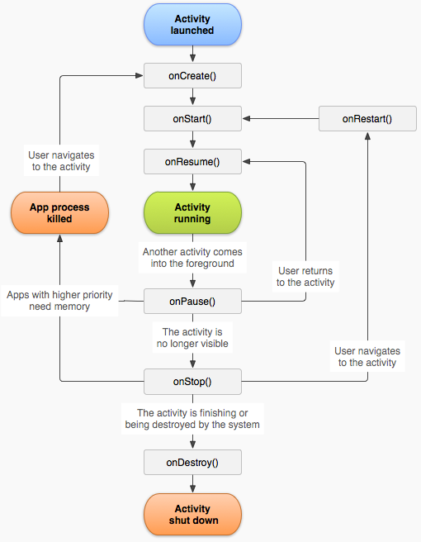
Activity Life Cycle (Cont.)
Source: http://developer.android.com/reference/android/app/Activity.html

Slide 7
Android Lifecycle
The Activity base class defines a series of events that govern the life cycle of an activity.
The Activity class defines the following events:
  onCreate() — Called when the activity is first created
  onStart() — Called when the activity becomes visible to the user
  onResume() — Called when the activity starts interacting with the user
  onPause() — Called when the current activity is being paused and the previous activity is being resumed
  onStop() — Called when the activity is no longer visible to the user
  onDestroy() — Called before the activity is destroyed by the system (either manually or by the system to conserve memory)
  onRestart() — Called when the activity has been stopped and is restarting again

Slide 8
Activity Monitoring
There are three key loops you may be interested in monitoring within your activity:
  The Entire Lifetime of an activity happens between the first call to onCreate(Bundle) through to a single final call to onDestroy().
  The Visible Lifetime of an activity happens between a call to onStart() until a corresponding call to onStop().
  The Foreground Lifetime of an activity happens between a call to onResume() until a corresponding call to onPause().

Slide 9

Entire Lifetime
An activity will do all setup of "global" state in onCreate(), and release all remaining resources in onDestroy().
For example, if it has a thread running in the background to download data from the network, it may create that thread in onCreate() and then stop the thread in onDestroy().

Slide 10
Visible Lifetime
During this time the user can see the activity on-screen, though it may not be in the foreground and interacting with the user.
Between these two methods you can maintain resources that are needed to show the activity to the user.
For example, you can register a BroadcastReceiver in onStart() to monitor for changes that impact your UI, and unregister it in onStop() when the user no longer sees what you are displaying.
The onStart() and onStop() methods can be called multiple times, as the activity becomes visible and hidden to the user.

Slide 11
Foreground Lifetime
During this time the activity is in front of all other activities and interacting with the user.
An activity can frequently go between the resumed and paused states so the code in these methods should be fairly lightweight.
For example when the device goes to sleep, when an activity result is delivered, when a new intent is delivered

Slide 12
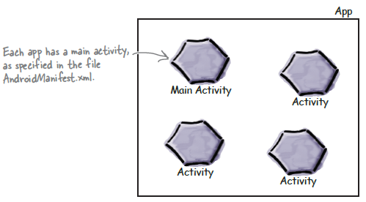
How do Activities Really Work?
An app is a collection of activities, layouts, and other resources

Slide 13
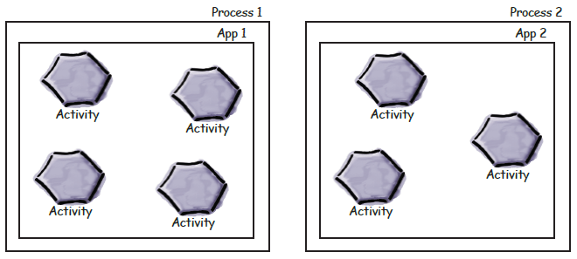
How do Activities Really Work?
By default, each app runs within its own process

Slide 14
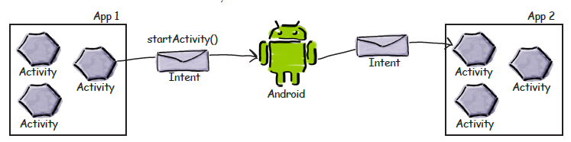
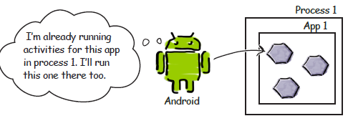
How do Activities Really Work?
You can start an activity in another application by passing an intent
with startActivity().
When an activity needs to start, android check if there’s already a
process for that app

Slide 15
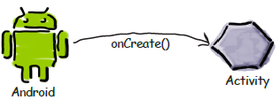
How do Activities Really Work?
When Android start an activity, it calls its oncreate() method

Slide 16
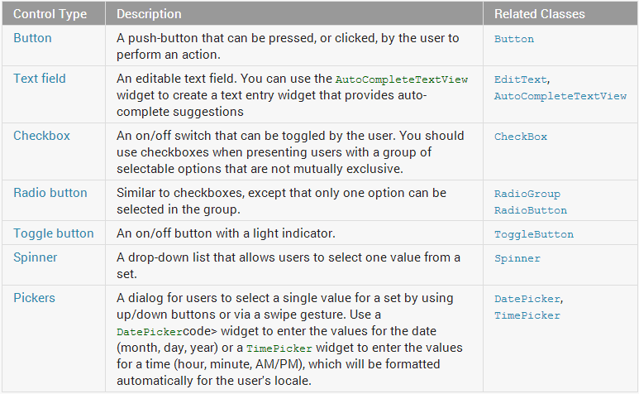
Input Controls

Slide 17
Basic Views
Buttons
Text Fields
Checkboxes
Radio Button
Toggle Button
Spinners
Pickers

Slide 18

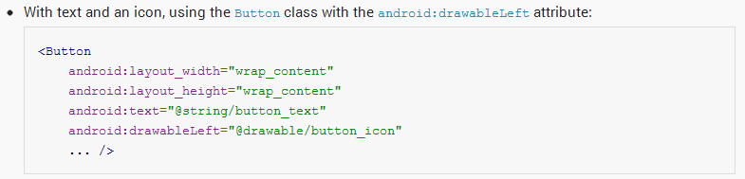
Buttons
A button consists of text or an icon (or both text and an icon) that communicates what action occurs when the user touches it.

Slide 19
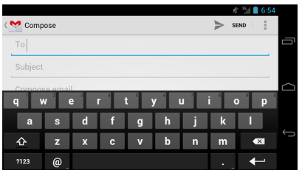
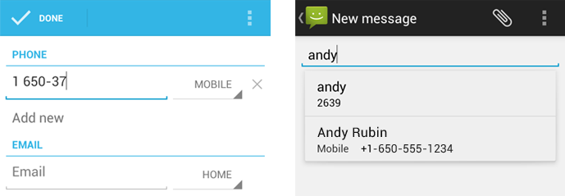
Text Fields
A text field allows the user to type text into your app. It can be either single line or multi-line.
Touching a text field places the cursor and automatically displays the keyboard.

Slide 20
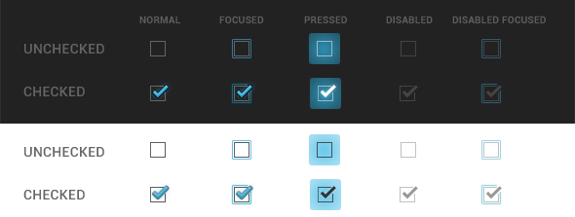

Checkboxes
Checkboxes allow the user to select multiple options from a set.
Avoid using a single checkbox to turn an option off or on. Instead, use an on/off switch.

Slide 21
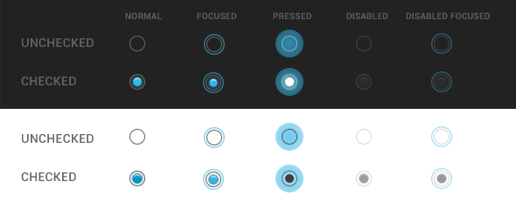
Radio Button
Radio buttons allow the user to select one option from a set.
Use radio buttons for exclusive selection if you think that the user needs to see all available options side-by-side. Otherwise, consider a spinner, which uses less space.

Slide 22

Toogle Button
A toggle button allows the user to change a setting between two states. You can add a basic toggle button to your layout with the ToggleButton object.
Android 4.0 (API level 14) introduces another kind of toggle button called a switch that provides a slider control, which you can add with a Switch object.

Slide 23
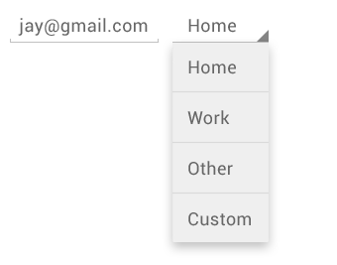
Spinners
Spinners provide a quick way to select one value from a set. In the default state, a spinner shows its currently selected value.
Touching the spinner displays a dropdown menu with all other available values, from which the user can select a new one.

Slide 24
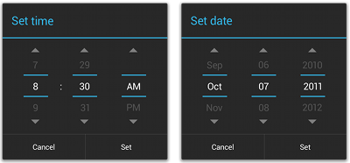
Pickers
Android provides controls for the user to pick a time or pick a date as ready-to-use dialogs.
Each picker provides controls for selecting each part of the time (hour, minute, AM/PM) or date (month, day, year).
Using these pickers helps ensure that your users can pick a time or date that is valid, formatted correctly, and adjusted to the user's locale.

Slide 25
Using Dialog Views
AlertDialog
DatePickerDialog
TimePickerDialog
Popups
Toast

Slide 26
Using Dialog Views
A dialog is a small window that prompts the user to make a decision or enter additional information.
A dialog does not fill the screen and is normally used for modal events that require users to take an action before they can proceed.
Note: Dialog Design
For information about how to design your
dialogs, including recommendations for language, read the Dialogs design guide.

Slide 27
Using Dialog Views
The Dialog class is the base class for dialogs, but you should avoid instantiating Dialog directly. Instead, use one of the following subclasses:
AlertDialog
A dialog that can show a title, up to three buttons, a list of selectable items, or a custom layout.
DatePickerDialog or TimePickerDialog
A dialog with a pre-defined UI that allows the user to select a date or time.

Slide 28
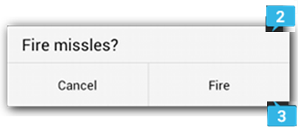
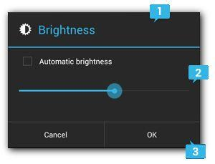
Alert Dialog
There are three regions of an alert dialog:
1. Title
This is optional and should be used only when the content area is occupied by a detailed message, a list, or custom layout.
2. Content area
This can display a message, a list, or other custom layout.
3. Action buttons
There should be no more than three action buttons in a dialog.
http://developer.android.com/guide/topics/ui/dialogs.html

Slide 29
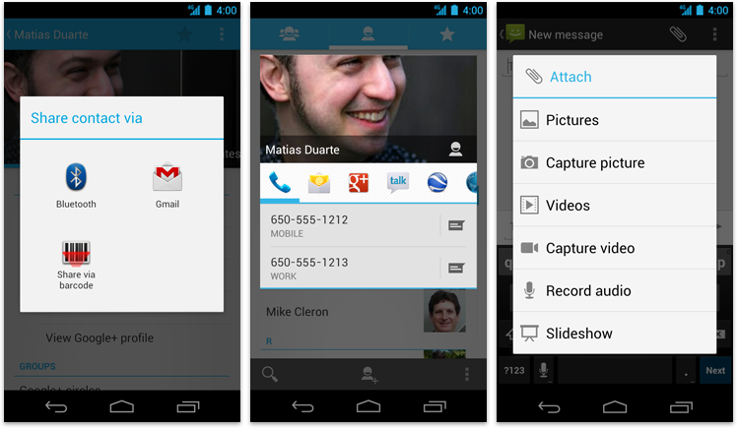
Popups
Popups are lightweight version of dialogs that require a single selection from the user.
Popups don't have explicit buttons that accept or cancel the operation. Instead, making a selection advances the workflow, and simply touching outside the popup dismisses it.

Slide 30
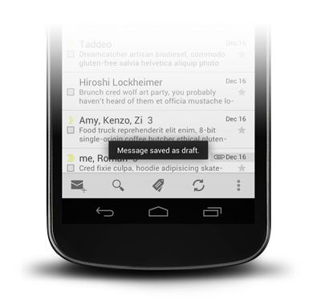
Toasts
Toasts provide lightweight feedback about an operation in a small popup.
For example, navigating away from an email before you send it triggers a "Draft saved" toast to let you know that you can continue editing later.
Toasts automatically disappear after a timeout.

Slide 31
Exercises
Please try Beer adviser and stopwatch app from book page 40 – 70 and 118 - 157

Slide 32
References
Head First Android Development. A Brain friendy guide. Dawn Griffiths and David Griffiths.O’reilly. ISBN:978-1-449-36218-8. Chapter 4 & Chapter 2
developer.android.com/guide/topics/ui/controls/

